Slide 1


Research Using Secondary Data
DEPH 312 Principles of Scientific Evidence
Talal Alshihayb ^{BDS, DScD}
Diplomate, American Board of Dental Public Health
Assistant Professor
Department of Preventive Dental Science, College of Dentistry, King Saud bin Abdulaziz University for Health Sciences
Department of Health Policy and Health Services Research, Henry M. Goldman School of Dental Medicine, Boston University
February 8, 2024
shihaybt@ksau-hs.edu.sa

Slide 2
Recap
Study tasks
Measures of disease occurrence
Measures of association
Study designs
Validity and precision
Random and systematic errors in research
Causality and causal effects
Variables and their description
Measures of central tendency and dispersion
Types of distributions and the theoretical distribution
Inferential statistics (p-values and confidence intervals)
Sampling
Evaluation of primary studies
Scientific writing

Slide 3

Introduction
3-5 paragraphs
Funnel shape
Logical sequence of sentences withing a paragraph
Smooth transition between paragraphs (start of a paragraph should be related to end of previous paragraph)
Should explain
General background
Specifics
Previous studies
Gaps/limitations of previous studies
Theoretical aspects (causal mechanism for why the exposure may affect the outcome)
Research question/hypothesis/aims/objectives
Use connecting words like moreover, furthermore, additionally, however, etc.
May be limited by number of words based on journal

Slide 4
Writing the introduction
Broad
Theme 1
Paragraph 1: Background of problem
Known
Theme 2
Paragraph 2: Specifics of problem
Known
Theme 3
Paragraph 3: More specifics of problem
Known
Theme 4
Paragraph 4: Identify the gap in the literature
Unknown
Research question
Theme 5
Paragraph 5: Your aim
Specific

Slide 5
Writing the methods
Should be very specific and detailed
If too many words, use online appendices or cite previous studies if methods were mentioned in them
Should explain
Data source
Study design
Target population (inclusion and exclusion criteria)
Sample size calculation
Variables (exposure, outcome, and covariates)
Measurements (data collection)
Validity and reliability of measurements
Statistical analysis
Sensitivity analysis (to check how sensitive results are to your study assumptions)

Slide 6
Writing the results
Start with population characteristics
Avoid presenting same results in tables/figures and text
Avoid interpretation of findings here (should be in discussion)
Should have
Baseline characteristics
Crude and adjusted measures of associations
Sensitivity analyses
Based on the order of your methods
Avoid table 2 fallacy (interpreting measures of associations of confounding variables in a model as causal effects)

Slide 7
Writing the discussion
Begin with summary of major findings
Discuss major findings and compare to previous studies
Explain why they were different
Limitations
Avoid mentioning strengths
Avoid mentioning more research is needed
Avoid giving recommendations based on the findings of your paper (a single paper)
This need a body of literature (more than one study)
You can discuss the implications of your research though only if supported by causal methods
Conclusion (can be a separate component depending on journal)

Slide 8
Take home message
Know your audience before you write
Select the journal before you write
Know the guidelines of the journal
Start writing early
Be clear and concise
Use appropriate grammar
Do not plagiarize
Use Grammarly
Read The Elements of Style by William Strunk Jr
Be critical of your writing
Take feedback from others
Practice a lot
Read more papers to write better

Slide 9
LECTURE LEARNING OUTCOMES OF EACH OF THE DIDACTIC SESSIONS
REFERENCE:
Chapter 11 in Modern Epidemiology 4th edition
Chapters 22 and 23 in Oral Epidemiology a Textbook on Oral Health Conditions, Research Topics and Methods
LECTURE LEARNING OUTCOMES:
Recognize the different sources of secondary data.
Recognize the potential of electronic health records for research.

Slide 10





Data types
Quantitative
Qualitative
Mixed

Slide 11


Data sources of quantitative data
Primary
Secondary
Rothman KJ, Greenland S, Lash TL, editors. Modern epidemiology. Lippincott Williams & Wilkins; 2021.

Slide 12





Data collection methods
Questionnaire (most frequent)
Extraction
Birth/death certificates
Medical records
Employment records
Biologic markers
Environmental samples
Examination
Rothman KJ, Greenland S, Lash TL, editors. Modern epidemiology. Lippincott Williams & Wilkins; 2021.

Slide 13











Questionnaire administration
Interviewer-administered
Self-administered
In-person
Telephone
Internet videoconference
Audio
Paper
Video
Electronic device
Rothman KJ, Greenland S, Lash TL, editors. Modern epidemiology. Lippincott Williams & Wilkins; 2021.

Slide 14
Questionnaire
Once variables are known
Use a pre-validated questionnaire
Develop your own questionnaire

Slide 15
Secondary data
Data collected by others
RCT
Cohort
Health records (electronic or paper)
Birth/death certificates
National surveillance data
Publicly available data by other entities (government, internet, non-profit, private, social media)
Data available upon request from other entities ((government, internet, non-profit, private, social media)
Etc.

Slide 16
RCT
Some studies use data from other RCTs

Slide 17
Cohort
Some studies use data from other cohorts

Slide 18
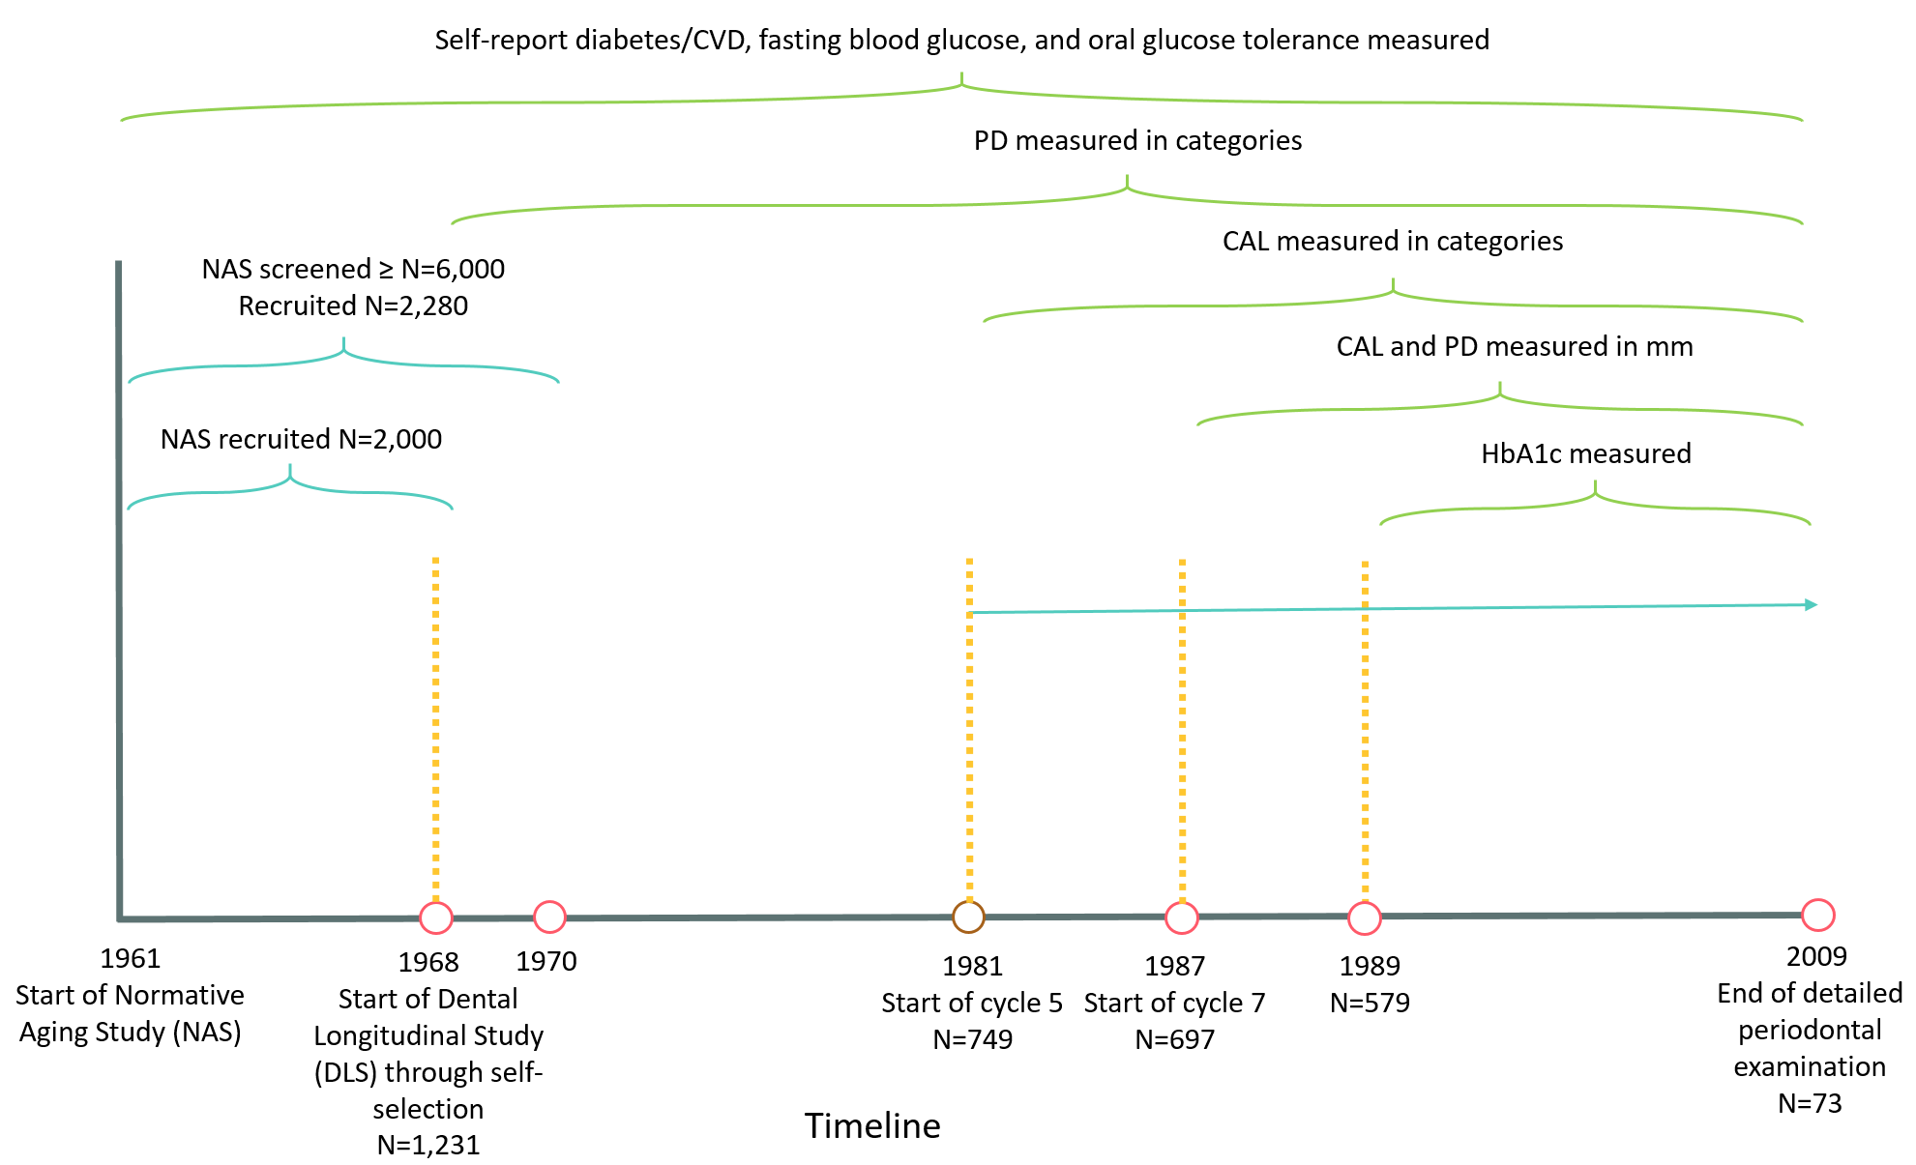

White men (98%)
Veterans (mostly)
Healthy
Married (mostly)
(Bell, Rose, & Damon, 1966; Bell, Rose, & Damon, 1972; R. Feldman, Dpurlass, Loftus, Kapur, & Chauncey, 1982; R. S. Feldman, Alman, & Chauncey, 1986; Kapur, Glass, Loftus, Alman, & Feller, 1972)

Slide 19
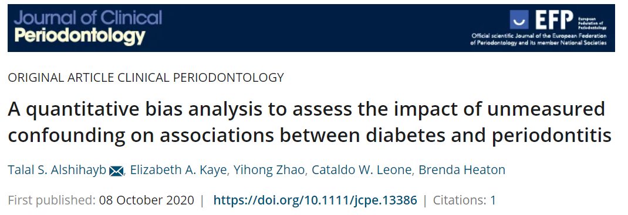







Slide 20
National surveillance data
Data collected on routinely basis to monitor diseases
Often cross-sectional designs

Slide 21
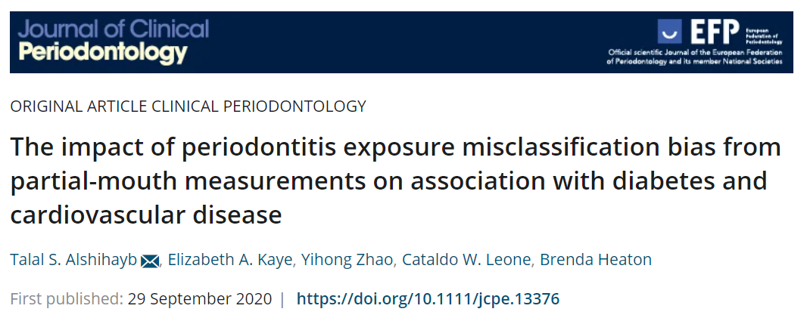
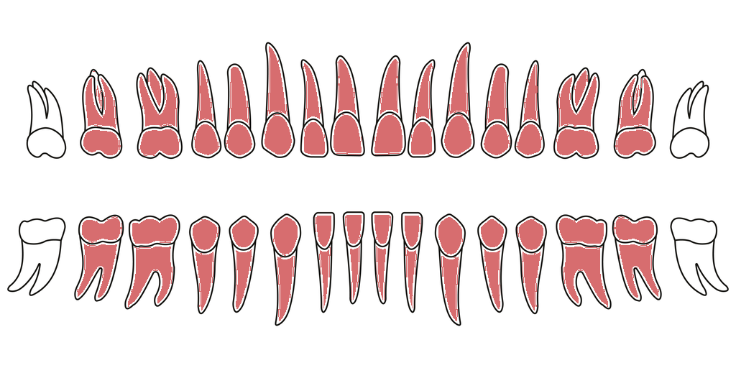
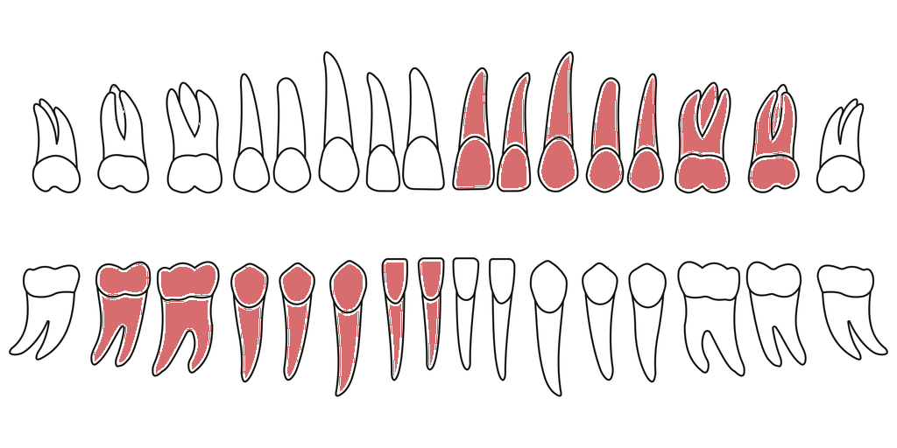


Slide 22
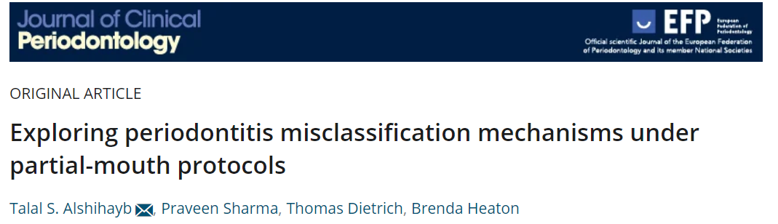






Slide 23
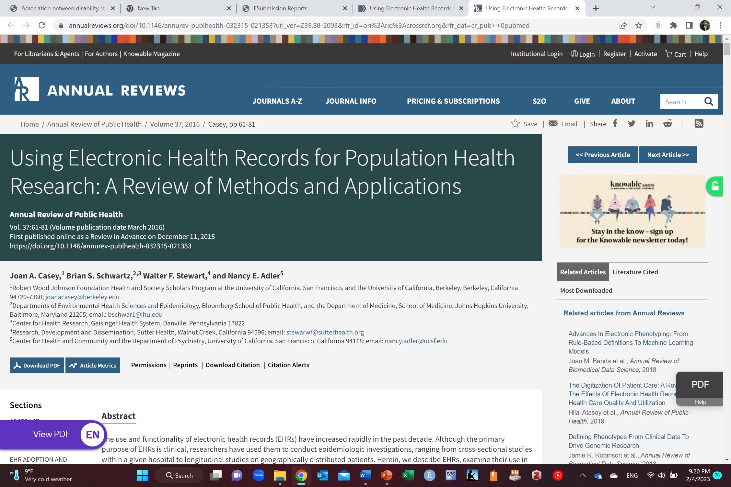
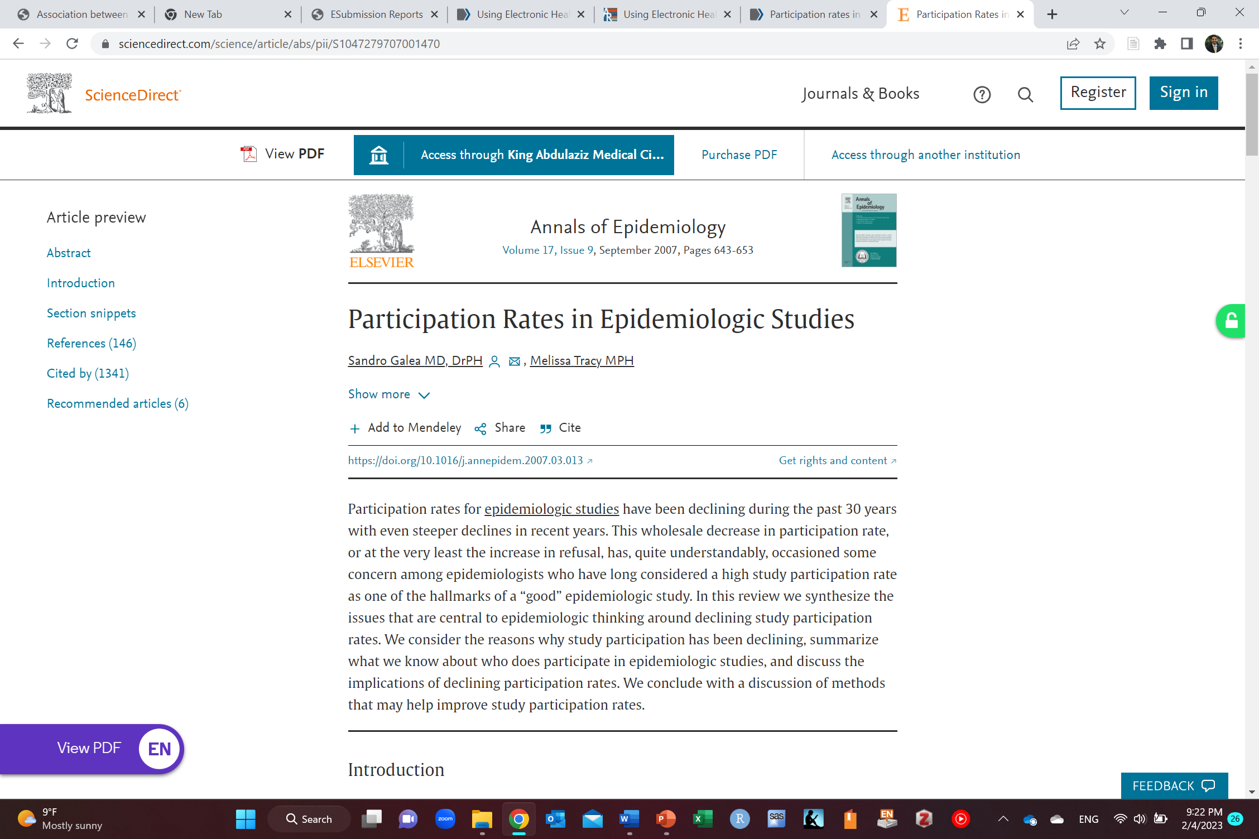
Health records
Electronic health records
This is becoming mainstream source of data for studies

Slide 24

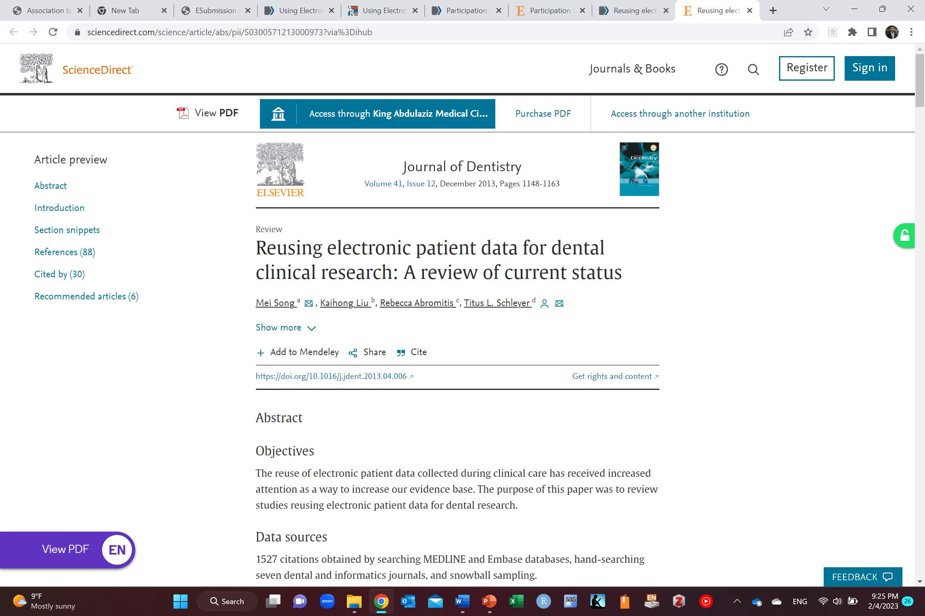
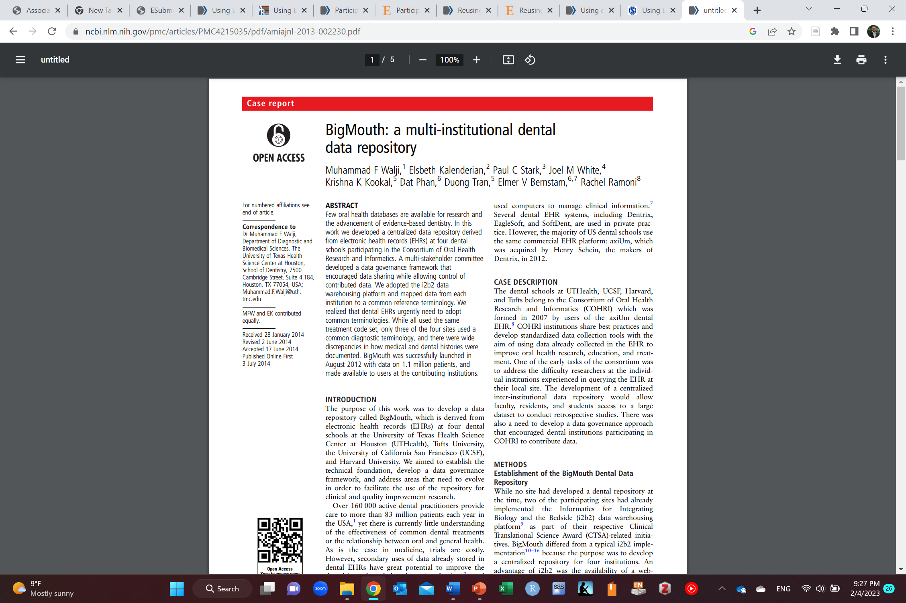

Slide 25


Slide 26

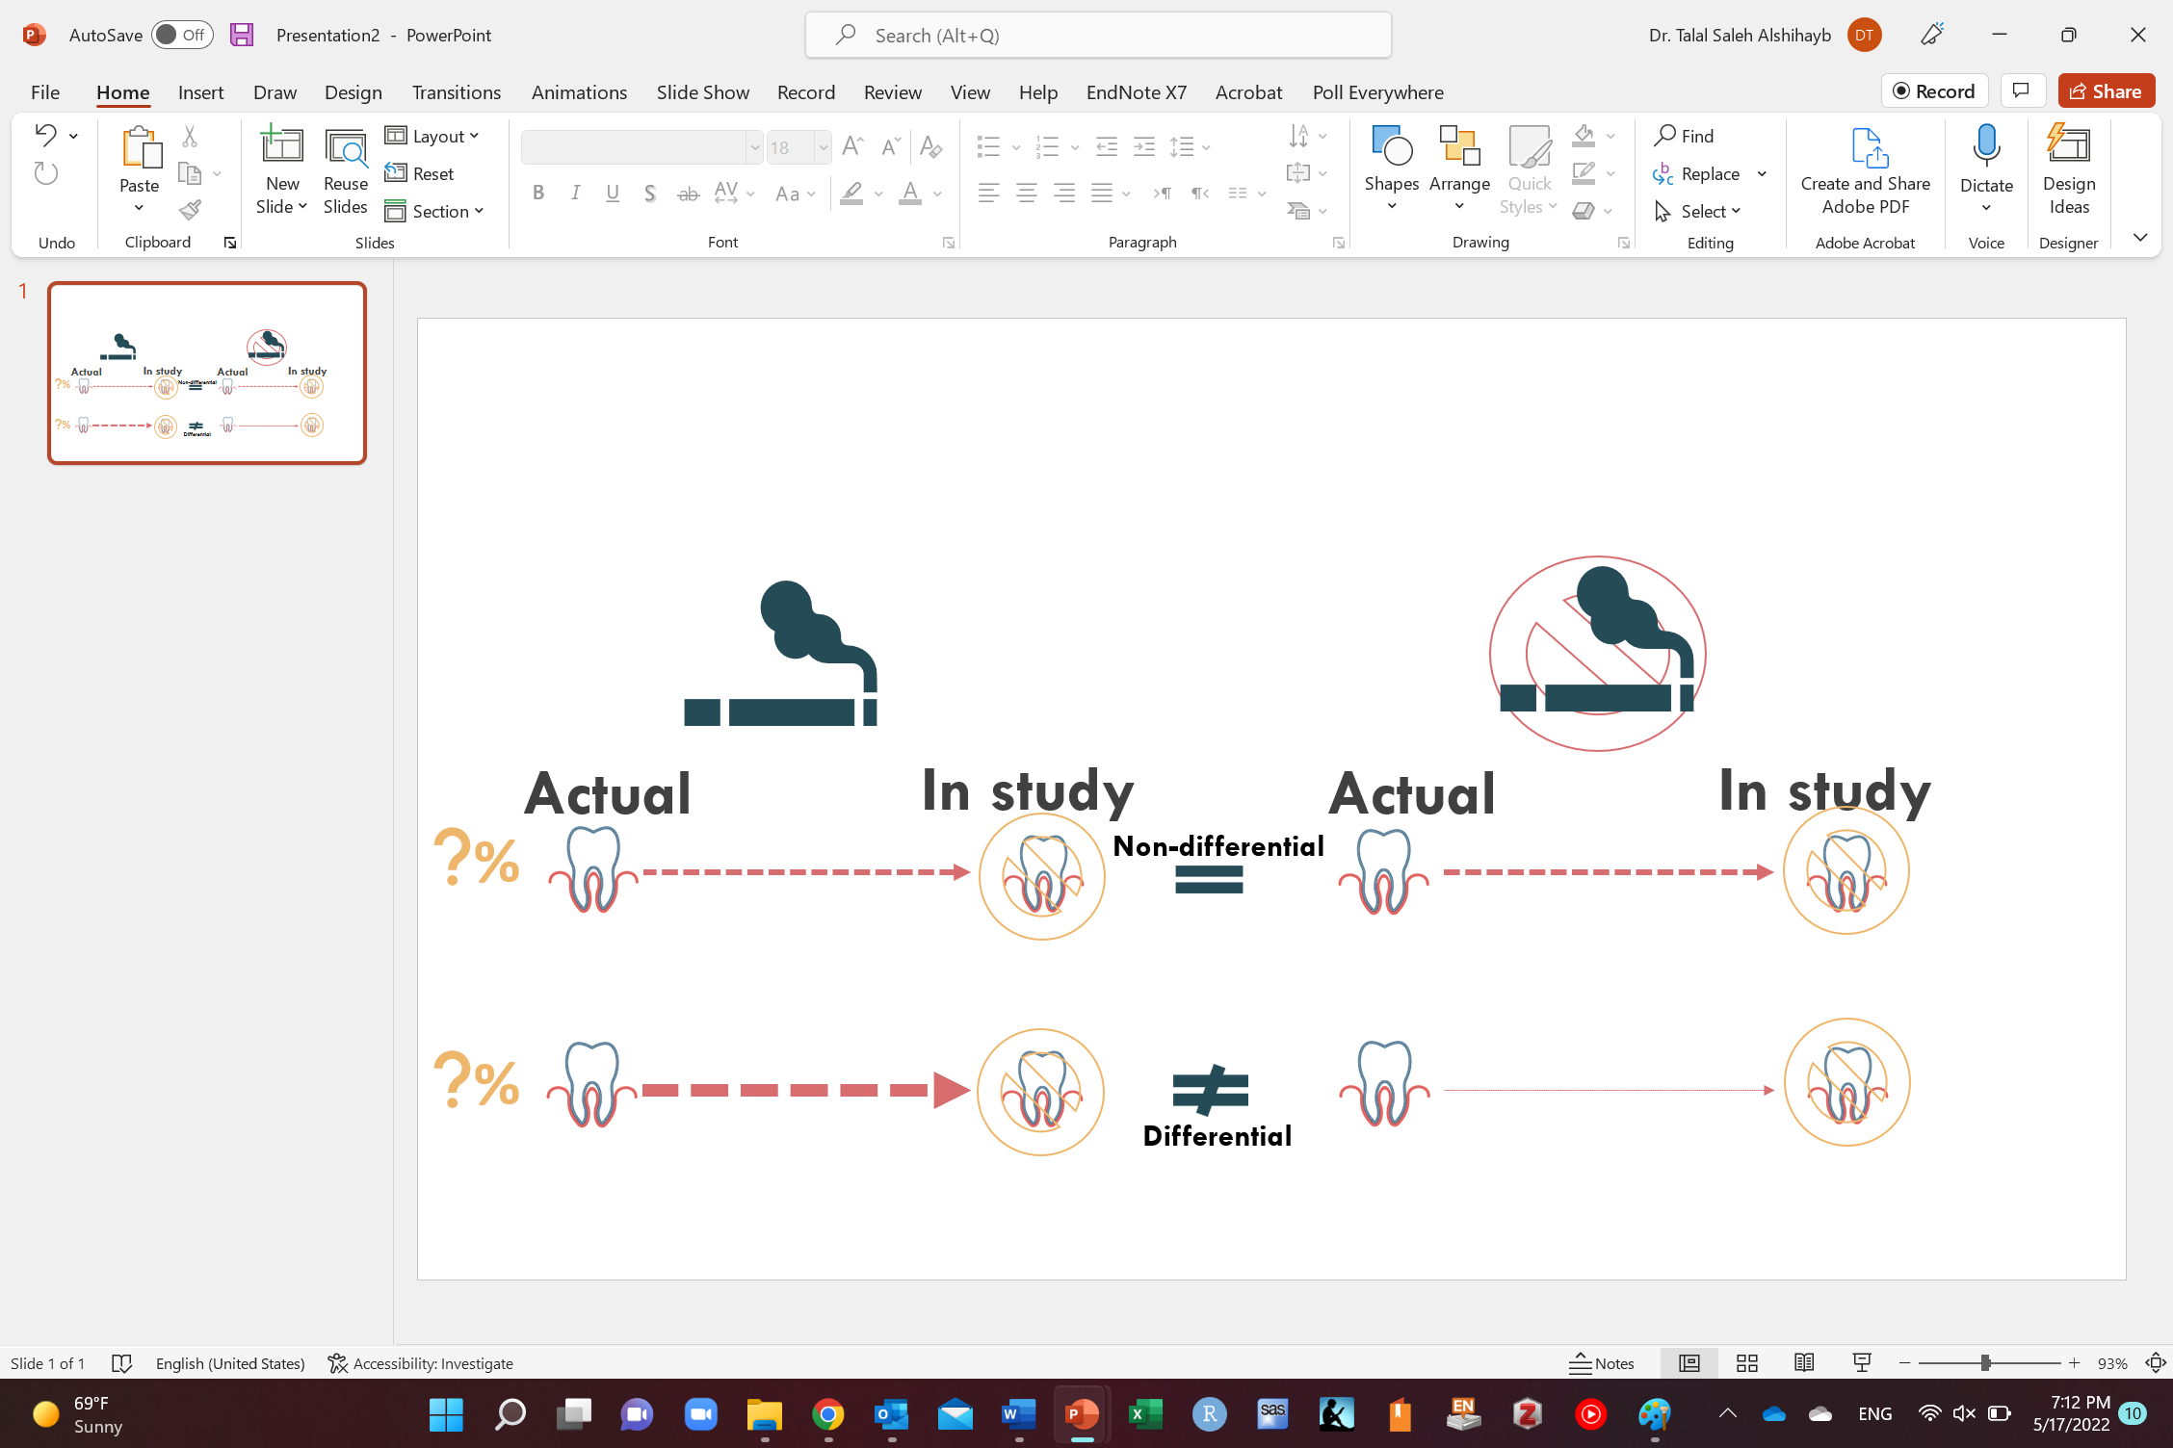

You can do studies with simulations
RD
0

Slide 27
My story
I was forced to get into KAIMRC Research Summer School after my 3rd year at King Saud University (D1 equivalent)
“It is hard when you have to and its easy when you want to”
“Where there is a will, there is a way”
No training in my curriculum except for a small part of a course in my last year as undergraduate
Multiple research failures before my postgrad
Online sources were not as easily available as now

Slide 28
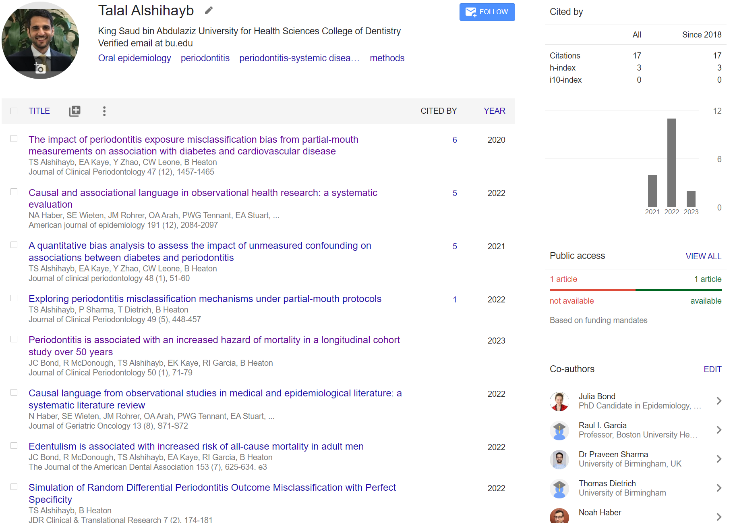

Slide 29

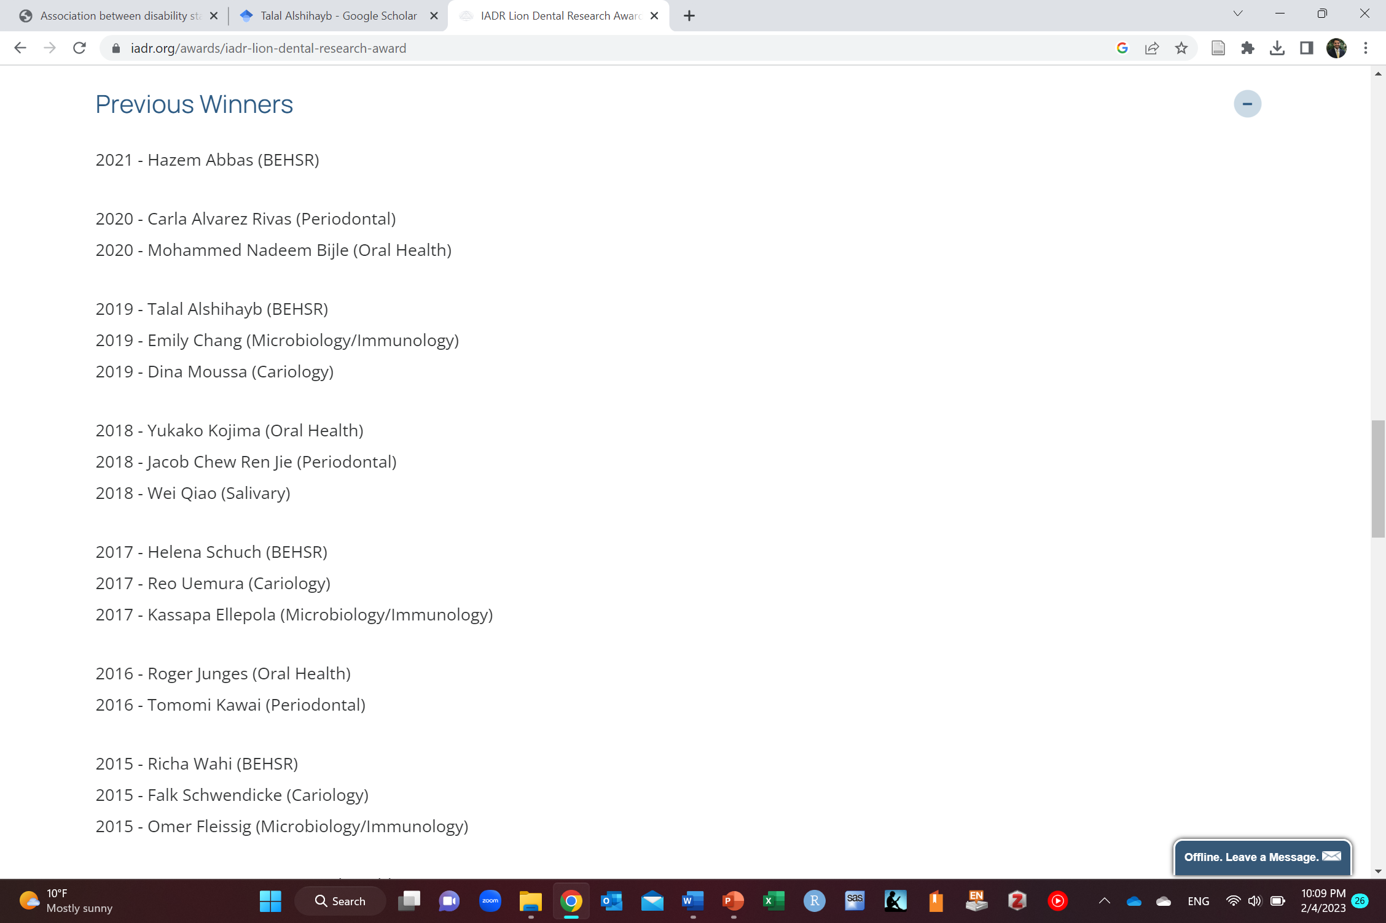


Slide 30
Moral of the story
You can still do it, if you want!
If I could do it, so could you (you are as smart as I am, if not smarter)
Validity of a study does not depend on
Winning a prize at a conference
Publication
Which journal
Etc.

Slide 31
Final remarks on current status of medical research

Slide 32
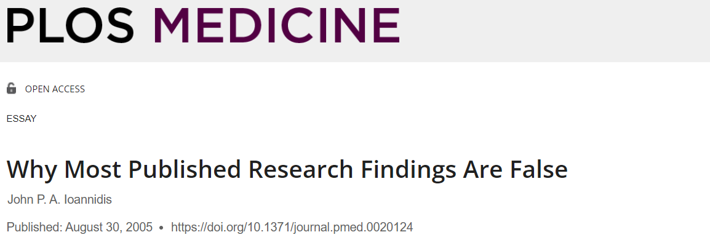

Slide 33


Slide 34
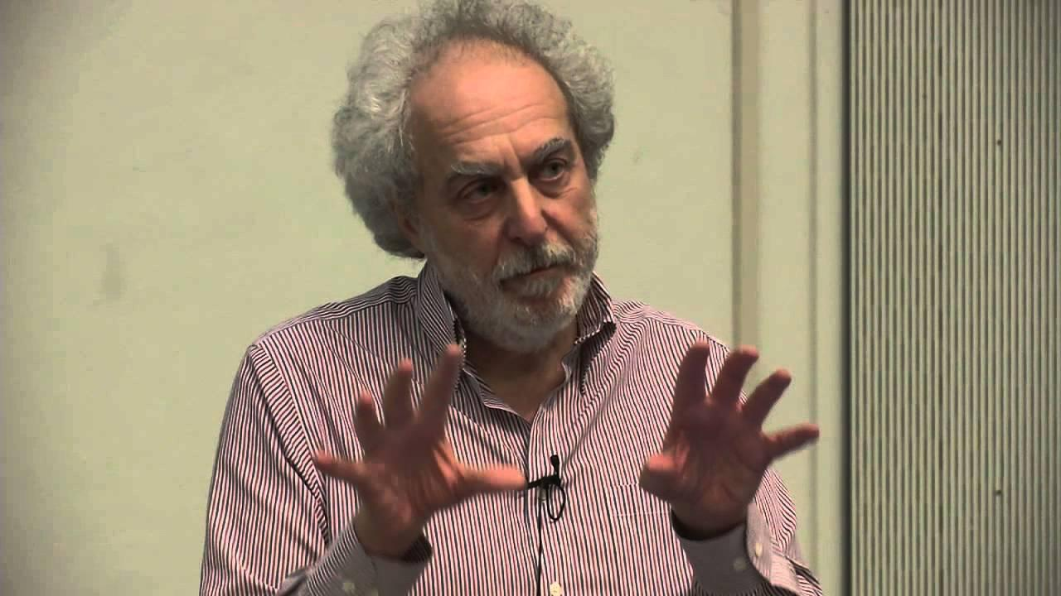
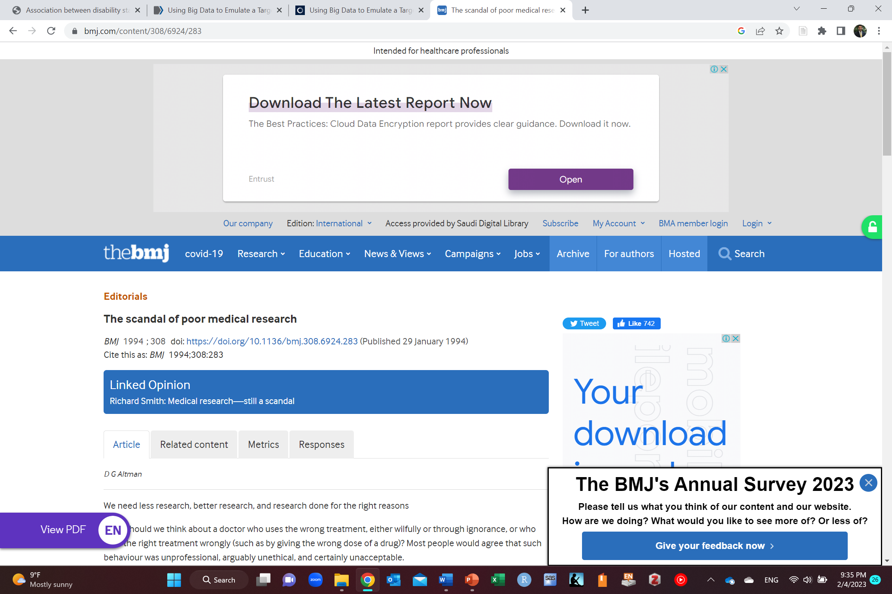

Robert Matthews et al. BMJ 2018;361:bmj.k2588
©2018 by British Medical Journal Publishing Group
“We need less research, better research, and research done for the right reasons”

Slide 35
Any Questions?
shihaybt@ksau-hs.edu.sa

